Slide 1

Round 33

Slide 2
INTRODUCTION
Project : Online Exam System
Our Team
Noyem Zahangir Md. Shakil Syed Mohamed
Porag (Team Leader) Chowdhury Abdul Awal
ID: 1237018 ID: 1230120 ID: 1237014
Farjana Abdul Selina
Yeasmin Mazid Sultana
ID: 1225104 ID: 1236179 ID: 1237978

Slide 3
PROBLEM DEFINE
Online Examination System, sometimes referred as e-examinations, are the examinations conducted through the internet for a remote examinee(s).
This system is applicable for any educational institute. They can easily take exams by using this system. First of all they have to be registered with the help of Application Admin.
Overall process for a specific institute will be valid for a specific period (which is defined on the agreement of Application Admin and Institute representative).

Slide 4
Why Online Examination ?
Stored Repository of exams
Available at a reduced cost
Results are available instantly
Accuracy in checking the answer, calculating result
Can be easily accessed 24/7 over the open test period
Secure because of authentication
Develop a system which allows the faculty to create, modify and store questions which can be grouped together to form sections and these sections can be grouped together to form tests/examinations.

Slide 5
PRESENTATION SESSION
Planning
Implementation
Question & Answer

Slide 6
ENTITY DEFINE
System Admin
Institute Admin
Examiner
Question Maker
Examinee

Slide 7
SYSTEM ADMIN
Control the overall system.
Could not access the Institute portion.
Authorizes the Institute Admin.
Provide User Name and Password.
Reset the password, block/unblock users.
Creates the different Institute category.
Edit information of Institute Admin.

Slide 8
INSTITUTE ADMIN
Log into the application by ID and password.
Register all examinees.
Set exam schedule or set time or cancel the exam.
Provides result with a print copy or via email.

Slide 9
EXAMINER
Assign examinees to set for exam.
Assign for subject .
Assign for supplies exam question.
Observe overall process of the examination.
Provide result hard copy.

Slide 10
QUESTION SETTER
Authorized by Institute Admin.
Create different types of questions.
Generate or supply the questions into the application.
Must be authorized questions from Ins. Admin after creating.

Slide 11
EXAMINEE
Examinee must be registered.
Take part many exam with same Application registration.
Can get result instantly.
View result or get a print copy or a soft copy via email.

Slide 12
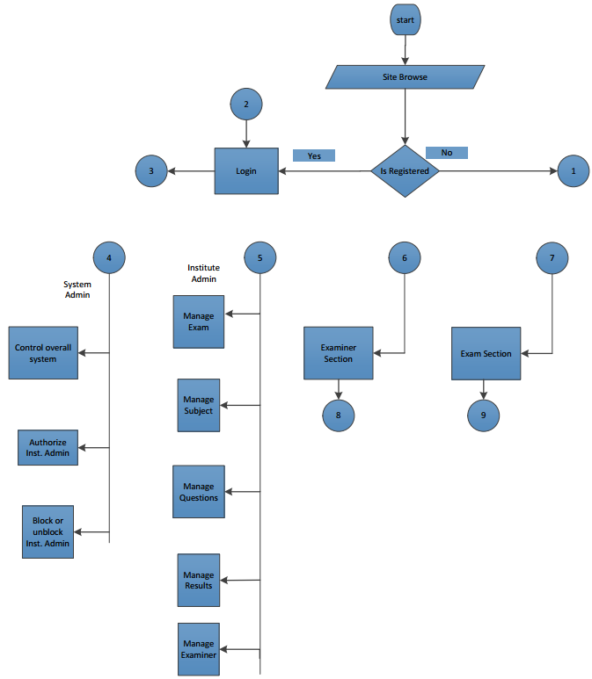
Figure : FlowChart of Online Exam System

Slide 13
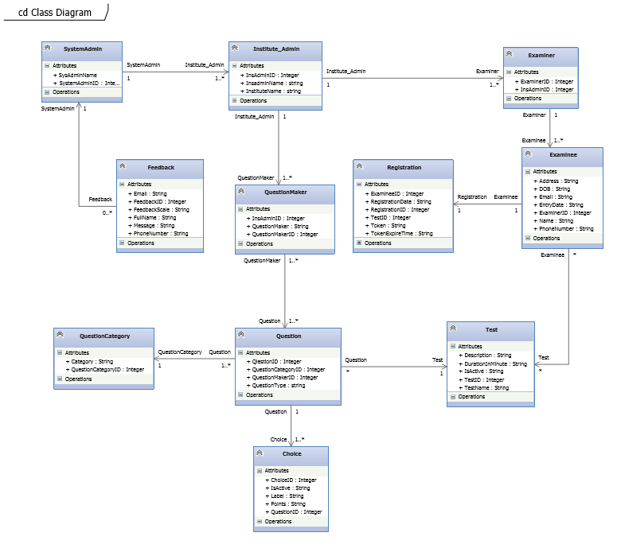
Figure: Class Diagram of Online Exam System

Slide 14
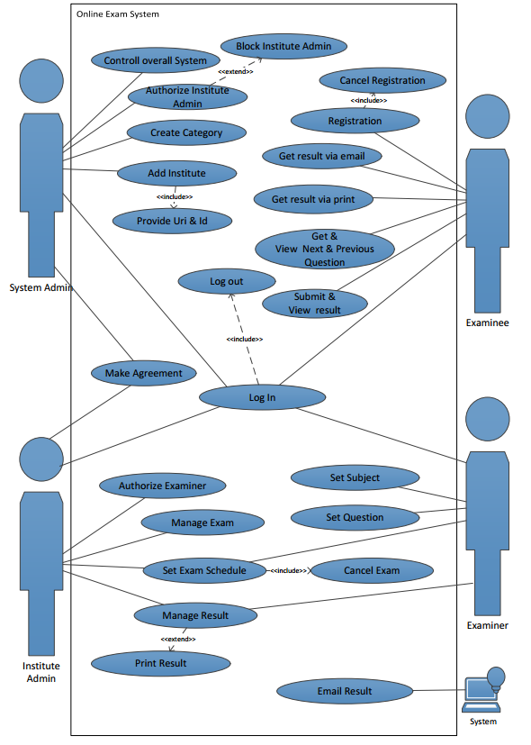
Figure: Usecase Diagram of Online Exam System

Slide 15
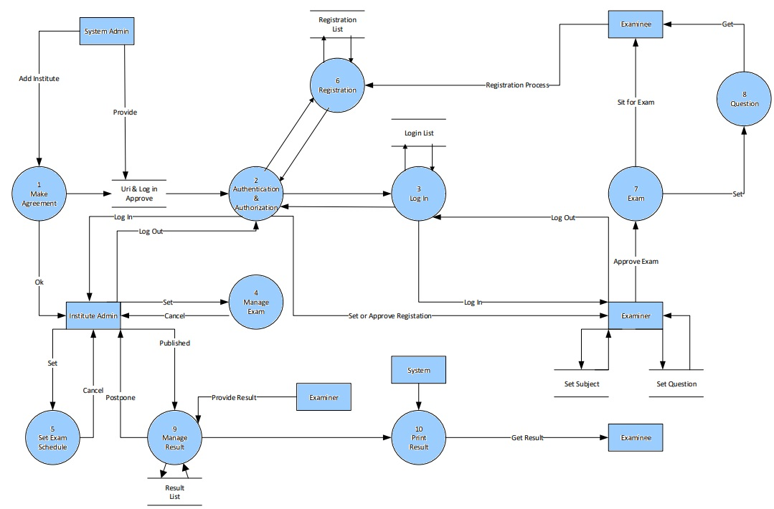
Figure : Data Flow Diagram of Online Exam System

Slide 16
IMPLEMENTATION

Slide 17
PROPOSED SYSTEM
After doing exam registration, an examinee can sit for exam within 48 hours.
Essay type questions for which evaluation criteria .
Supports multimedia files while forming various types of questions.
Drag & Drop Questions Category.

Slide 18
THANK YOU
Thanks to you all for give opportunity to represent our project presentation in front of you all.

